Slide 1
Modeling of CTN Detrapping 25년 9-11월 연구 정리 진명

Slide 2
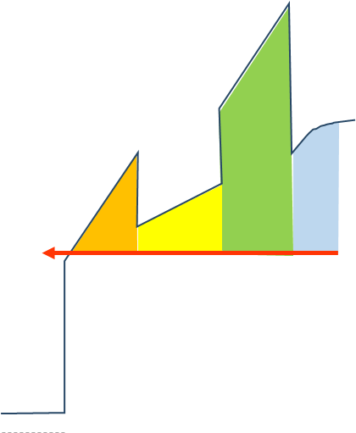

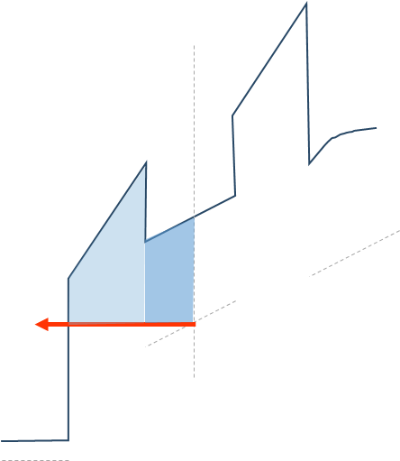







Detrapping from CTN Idea
CTN
BE-TOX (ONO)
CTN
$e_{n, CTN }$
o1 layer
o2 layer
n1 layer
$e_{n, CTN }$
$E_{Fi}$
$e_{n, BETOX}$
Previous research,
$E_{Fi}$
$e_{n, BETOX}$
BETOX (ONO)
$E_{Fi}$

Slide 3
CTN Trapped Charge Detrapping
Detrapping mechanisms in retention of 3-D NAND flash vertical cross section
② CTN Detrapping to channel (Ch)
BETOX
CTN
BOX
③ CTN Detrapping to wordline (WL)
① BETOX Detrapping [1]
Ch
WL
[1] Jin, TED, 2025

Slide 4

CTN Electron Emission Simulation Method
① BETOX Detrapping [1] (previous study)
From Last Research…
Vertical Partition Method
=> Uniform field assumption
② CTN Detrapping to Ch
③ CTN Detrapping to WL
CTN
Same Implementation
Vertical Partition Method
=> Non-uniform field!
$e_{n, CTN }$

Slide 5
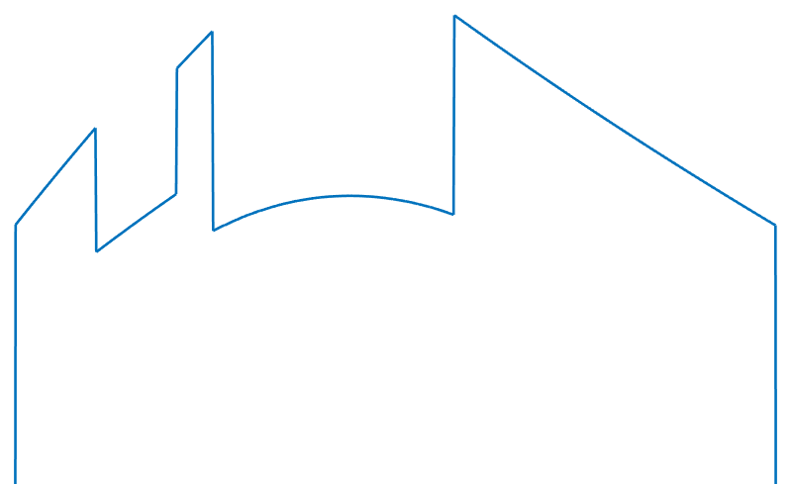
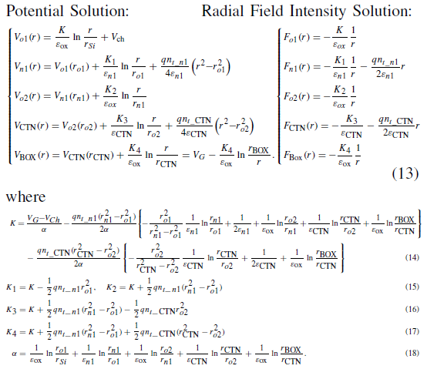
CTN Model Poisson in Partitions
Original method: only a block of uniformly distributed trap model
New method: partitioned CTN model
Detailed Poisson Solution needed!

Slide 6

Detailed Poisson Solution
Used Poisson equation – electrical potential solutions
$V_{o1}\left(r\right)=\frac{K_{o1}}{ε_{o1}}\ln{\frac{r}{r_{Si}}}$
$V_{n1}\left(r\right)=\frac{K_{o1}}{ε_{o1}}\ln{\frac{r_{o1}}{r_{Si}}}+\frac{K_{n1}}{ε_{n1}}\ln{\frac{r}{r_{o1}}}+\frac{qn_{t_n1}}{4ε_{n1}} \left(r^{2}−r_{o1}^{2}\right)$
$V_{o2}\left(r\right)=V_{n1}\left(r_{n1}\right)+\frac{K_{o2}}{ε_{ox}}\ln{\frac{r}{r_{n1}}}$
i = 1
$V_{CTN,1}\left(r\right)=V_{o2}\left(r_{o2}\right)+\frac{K_{CTN,1}}{ε_{CTN}}\ln{\frac{r}{r_{o2}}}+\frac{qn_{t_CTN,1}}{4ε_{CTN}}\left(r^{2}−r_{o2}^{2}\right)$
i = 2 ~ N
$V_{CTN,i}\left(r\right)=V_{CTN,i−1}\left(r_{CTN,i−1}\right)+\frac{K_{CTN,i}}{ε_{CTN}}\ln{\frac{r}{r_{tox}}}+\frac{qn_{t_CTN,i}}{4ε_{CTN}}\left(r^{2}−r_{CTN,i−1}^{2}\right)$
$V_{BOX}\left(r\right)=V_{CTN,N}\left(r_{CTN,N}\right)+\frac{K_{BOX}}{ε_{BOX}}\ln{\frac{r}{r_{CTN,N}}}$
CTN Partition in N
Now, K-constants can be determined from the boundary conditions

Slide 7



Detailed Poisson Solution
Boundary Conditions
r = r_{o1}
$K_{o1}=K_{n1}+\frac{1}{2}qn_{t_n1}r_{o1}^{2}$
r = r_{n1}
$K_{n1}+\frac{1}{2}qn_{t_n1}r_{o1}^{2}=K_{o2}$
r = r_{o2}
$K_{o2}=K_{CTN,1}+\frac{1}{2}qn_{t_CTN,1}r_{o2}^{2}$
$K_{CTN,i−1}+\frac{1}{2}qn_{t_CTN,i−1}r_{CTN,i−1}^{2}=K_{CTN,i}+\frac{1}{2}qn_{t_CTN,i}r_{CTN,i−1}^{2}$
r = r_{CTN,i-1}
r = r_{CTN,N}
$K_{CTN,N}+\frac{1}{2}qn_{t_CTN,N}r_{CTN,N}^{2}=K_{BOX}$
Unknowns K_{o1}, K_{n1}, K_{o2}, K_{CTN,1~N} , K_{BOX} : Total N+4
Above equations r_{o1}, r_{n1}, r_{o2}, r_{CTN,1~N} : Total N+3
One more BC needed

Slide 8

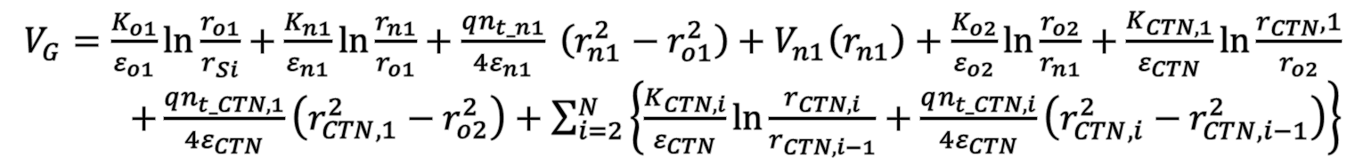
Detailed Poisson Solution
Boundary Condition : Gate Voltage
$V_{BOX}\left(r\right)=V_{CTN,N}\left(r_{CTN,N}\right)+\frac{K_{BOX}}{ε_{BOX}}\ln{\frac{r}{r_{CTN,N}}}$
$r= r_{BOX}$
$V_{BOX}\left(r_{BOX}\right)=V_{CTN,N}\left(r_{CTN,N}\right)+\frac{K_{BOX}}{ε_{BOX}}\ln{\frac{r_{BOX}}{r_{CTN,N}}}=V_{G}$
in result,
$V_{G}=\frac{K_{o1}}{ε_{o1}}\ln{\frac{r_{o1}}{r_{Si}}}+\frac{K_{n1}}{ε_{n1}}\ln{\frac{r_{n1}}{r_{o1}}}+\frac{qn_{t_n1}}{4ε_{n1}} \left(r_{n1}^{2}−r_{o1}^{2}\right)+V_{n1}\left(r_{n1}\right)+\frac{K_{o2}}{ε_{o2}}\ln{\frac{r_{o2}}{r_{n1}}}+\frac{K_{CTN,1}}{ε_{CTN}}\ln{\frac{r_{CTN},1}{r_{o2}}}$ $+\frac{qn_{t_CTN,1}}{4ε_{CTN}}\left(r_{CTN,1}^{2}−r_{o2}^{2}\right)+\sum_{i=2}^{N}{\left\{\frac{K_{CTN,i}}{ε_{CTN}}\ln{\frac{r_{CTN,i}}{r_{CTN,i−1}}}+\frac{qn_{t_CTN,i}}{4ε_{CTN}}\left(r_{CTN,i}^{2}−r_{CTN,i−1}^{2}\right)\right\}}$
Now, unknowns can be solved

Slide 9
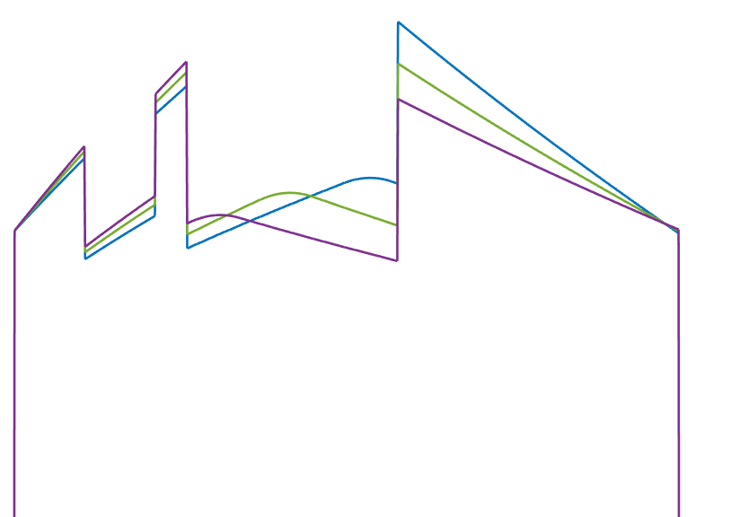
Poisson Solution Variations
Si
BETOX
CTN
BOX
WL
Si
BETOX
CTN
BOX
WL
Si
BETOX
CTN
BOX
WL
o1
n1
o2
o1
n1
o2
o1
n1
o2
$$r_{Si}$$
$$r_{o1}$$
$$r_{n1}$$
$$r_{o2}$$
$$r_{ctn}$$
$$r_{box}$$
$$r$$
$$r_{Si}$$
$$r_{o1}$$
$$r_{n1}$$
$$r_{o2}$$
$$r_{ctn}$$
$$r_{box}$$
$$r$$
$$r_{Si}$$
$$r_{o1}$$
$$r_{n1}$$
$$r_{o2}$$
$$r_{ctn}$$
$$r_{box}$$
$$r$$
-qn_{t_n1}
-qn_{t_n1}
-qn_{t_n1}
$$t_{o1}$$
$$t_{n1}$$
$$t_{o2}$$
$$t_{ctn}$$
$$t_{box}$$
$$t_{o1}$$
$$t_{n1}$$
$$t_{o2}$$
$$t_{ctn}$$
$$t_{box}$$
$$t_{o1}$$
$$t_{n1}$$
$$t_{o2}$$
$$t_{ctn}$$
$$t_{box}$$
Variations of trap distributions also can be discussed

Slide 10
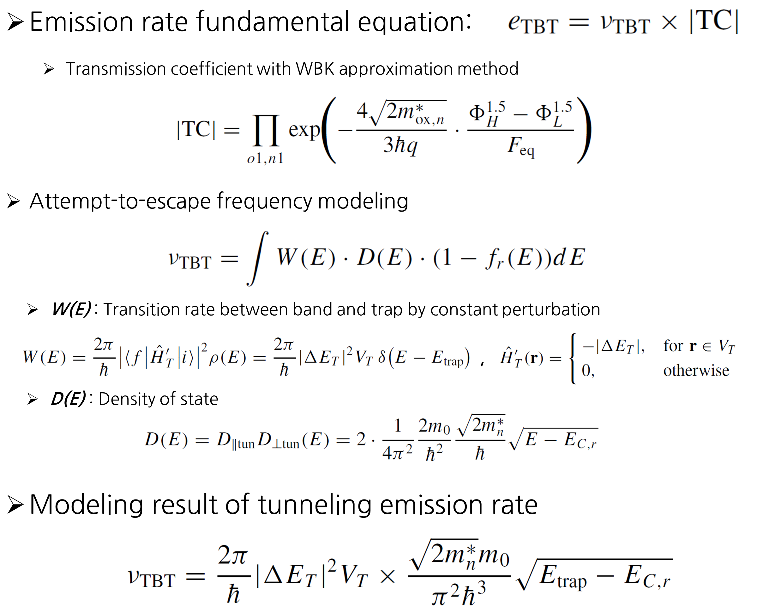
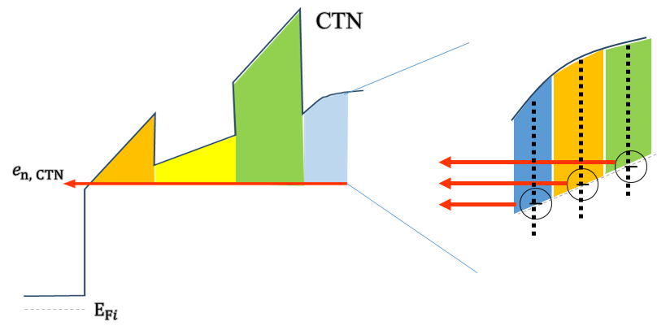
CTN Detrapping Simulation Method
BETOX Detrapping Summary
BE-TOX (ONO)
o1 layer
n1 layer
o2 layer
CTN
Si-channel
(reservoir)
TC_{n1}
|ΔE_{T}|
E_{trap}
E_{C,r}
E_{trap} > E_{C,r}
For emission
TC_{o1}
CTN Detrapping Emission Modeling based on Detailed Poisson Solution

Slide 11
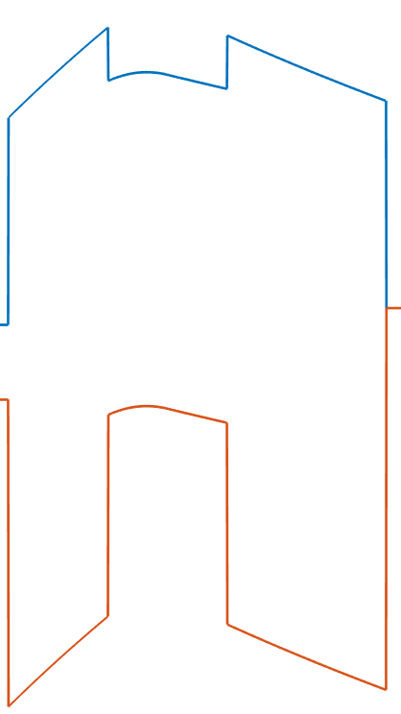
Cell Information Methodology
E_{c}
…
…
…
C_{ij}
…
E_{g}
E_{v}
Each cell C_{ij} contains information
Location (i)
Trap depth (j)
Trap concentration
Emission rate to channel direction
Emission rate to wordline direction

Slide 12
Cell Information Methodology
r
E_{c}
E_{t}
E_{t, j}
C_{ij}
E_{g}
r_{i}
E_{v}
Location (i)
Trap depth (j)
Used for cell monitoring
Location & trap depth saved at center point

Slide 13
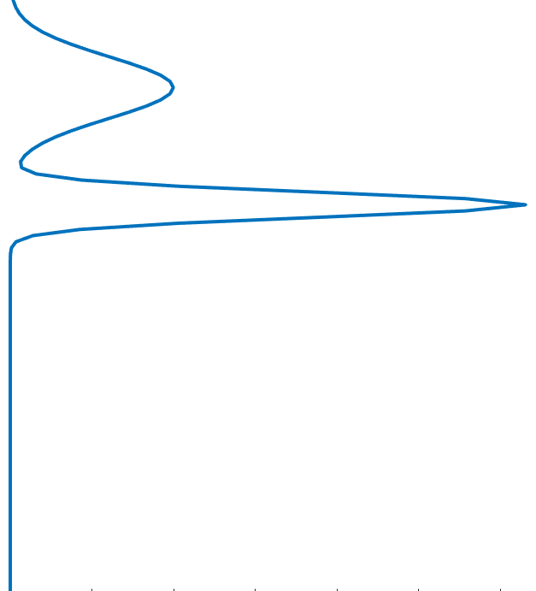


Cell Information Methodology
Trap concentration
- local trap concentration based on location & trap depth
$n_{t}= ∫D_{t}\left(E_{t}\right)dE_{t}$
…
$n_{t0,i,j}=D_{t}dE_{t}$
…

Slide 14
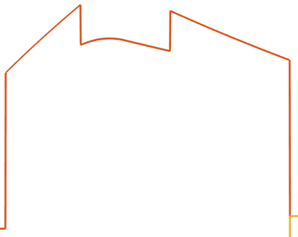



Cell Information Methodology
Emission rate to channel direction
(5) Emission rate to wordline direction
Electron emission to channel
$e_{ch}=ν_{ch}×{\left|TC\right|}_{ch}$
$e_{WL}=ν_{WL}×{\left|TC\right|}_{WL}$
Electron emission to wordline
WL
channel
$$n_{t}=\sum_{i, j}{n_{t,i,j}}=\sum_{i, j}{n_{t0,i,j} \left\{\exp\left(−e_{ch,i,j} t\right)+\exp\left(−e_{WL,i,j} t\right)\right\}}$$

Slide 15
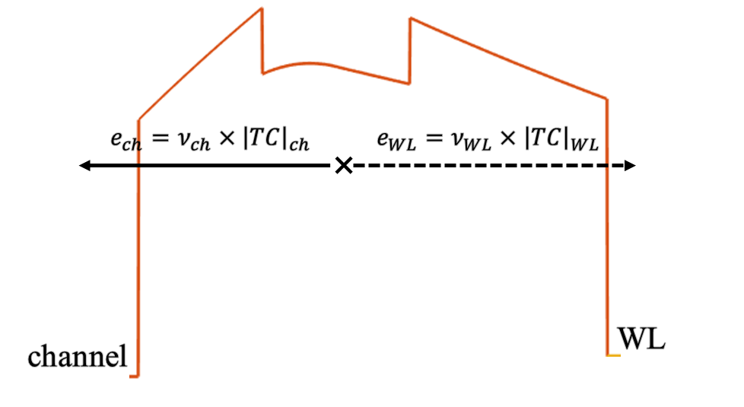
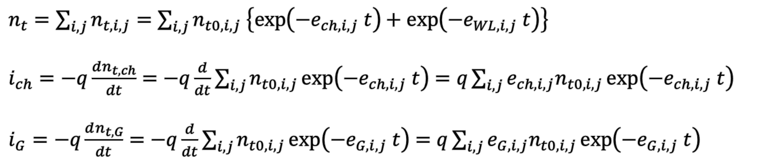
Equivalent Circuit
Equivalent circuit modeling as dependent current source
ΔV_{th}
i_{G}
i_{ch}
$n_{t}=\sum_{i, j}{n_{t,i,j}}=\sum_{i, j}{n_{t0,i,j} \left\{\exp\left(−e_{ch,i,j} t\right)+\exp\left(−e_{WL,i,j} t\right)\right\}}$
$i_{ch}=−q\frac{dn_{t, ch}}{dt}=−q\frac{d}{dt}\sum_{i, j}{n_{t0,i,j}\exp\left(−e_{ch,i,j} t\right)}=q\sum_{i, j}{e_{ch,i,j}n_{t0,i,j}\exp\left(−e_{ch,i,j} t\right)}$
$i_{G}=−q\frac{dn_{t, G}}{dt}=−q\frac{d}{dt}\sum_{i, j}{n_{t0,i,j}\exp\left(−e_{G,i,j} t\right)}=q\sum_{i, j}{e_{G,i,j}n_{t0,i,j}\exp\left(−e_{G,i,j} t\right)}$
=> Modeling by leakage current is on progress

Slide 16
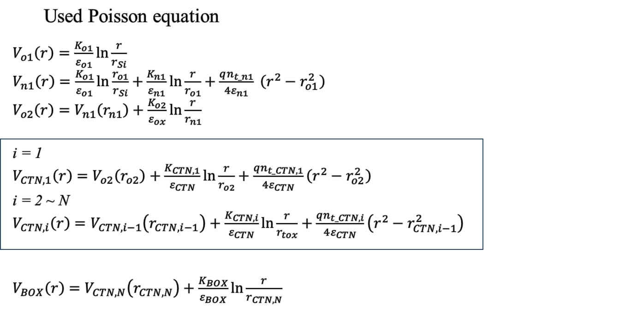
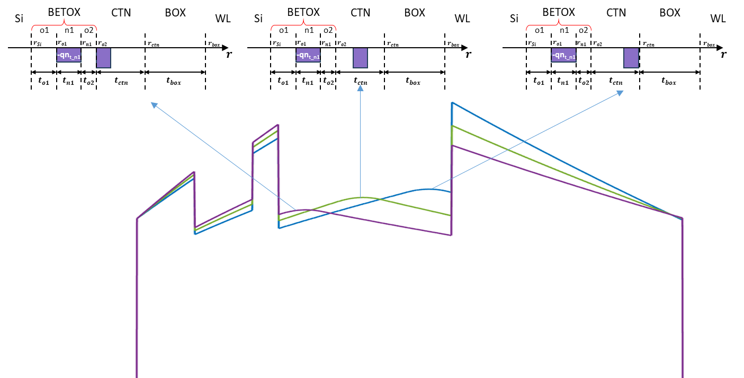
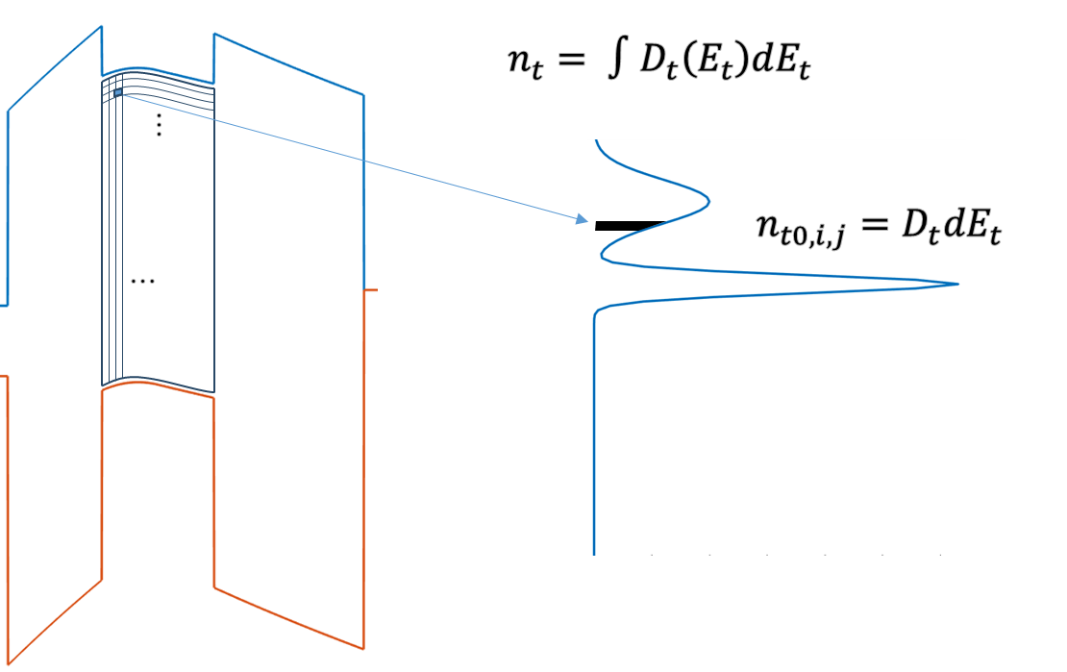
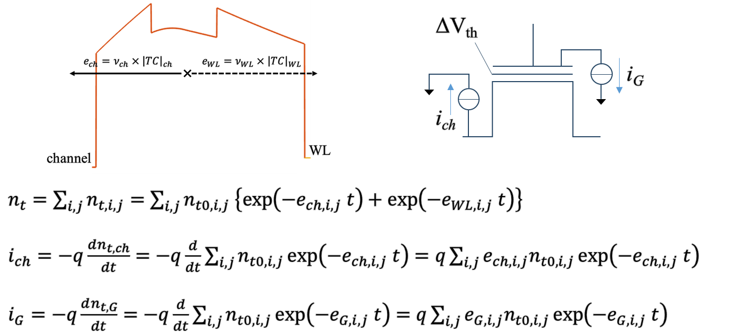
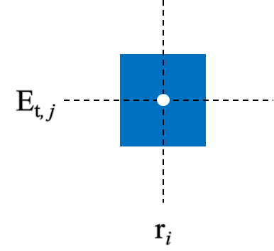
Summary
Detailed Poisson equation solution solved for CTN trap distribution
Cell information methodology / Modeling leakage current

